Slide 1
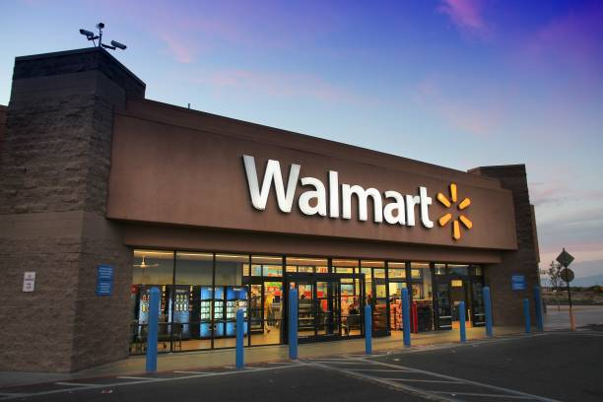
Walmart Sales Performance Analysis using Advanced SQL
BY nivedha

Slide 2
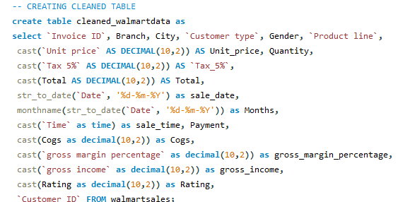
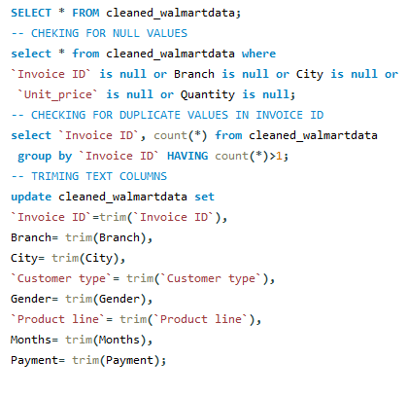
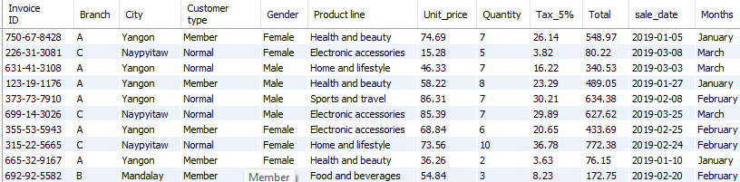
Cleaning and Transforming the data in SQL

Slide 3
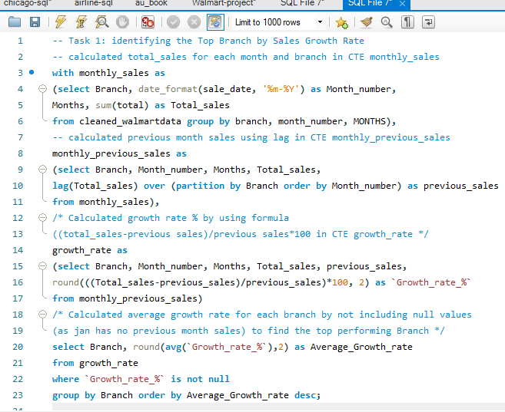

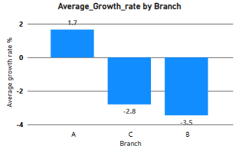
Task 1: Identifying the Top Branch by Sales Growth Rate
Key Insights:
Average monthly-sales growth rate percentage has been calculated for each branch.
Branch A is leading with 1.66% average growth-rate.
Branches C and B are experiencing negative growth, with significant declines of -2.80% and -3.45% respectively.
Recommendations:
Follow Branch A successful strategies in Branches B and C.
Run targeted promotions and loyalty programs to boost customer traffic.
Optimize product mix based on local demands.
Improve operational efficiency to reduce losses

Slide 4
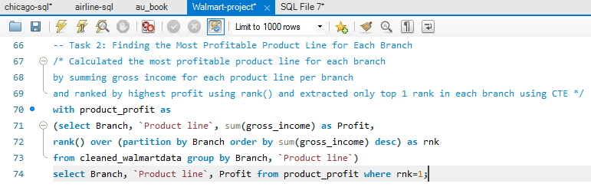
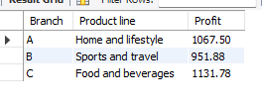
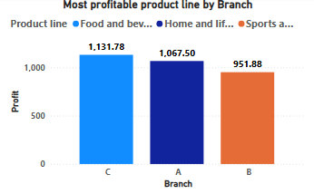
Task 2: Finding the Most Profitable Product Line for Each Branch
Key Insights:
In Branch A, the most profitable product line is “Home and Lifestyle” with profit of 1067.50.
In Branch B, “Sports and Travel” product line gives highest profit of 951.88.
In Branch C “Food and Beverages” is the most profitable product line with profit of 1131.78. Which is highest profit compared to other branches.
Recommendations:
Branch A: Increase marketing for “Home and Lifestyle” products and expand variety to sustain leadership.
Branch B: Focus promotions and seasonal campaigns on “Sports and Travel” to boost its sales further.
Branch C: Leverage “Food and Beverages” dominance with bundle offers and loyalty programs to maintain the top position.
Cross sell top performing product lines to improve overall branch profitability.

Slide 5
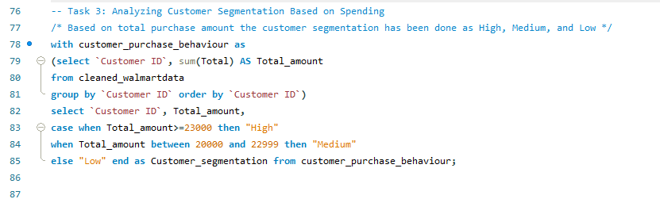
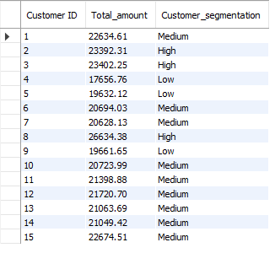
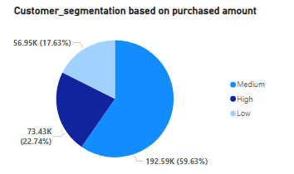
Task 3: Analyzing Customer Segmentation Based on Spending
Key Insights:
From given data the top 20% of total sales (>=23000) spent customers are segmented as High. Bottom 20% of total sales (<=19999) spent customers are segmented as Low. The other 60% (between 20k and 22999) spent customers are Medium.
High-level customers: 22.74%, Medium level customers: 59.63%, and Low-level customers: 17.63%.
Recommendations:
High-level customers: Offer VIP loyalty programs and exclusive discounts to retain and upsell.
Medium-level customers: Target with personalized promotions to move them into the high-level category.
Low-level customers: Use entry level offers.

Slide 6
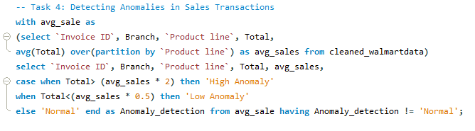
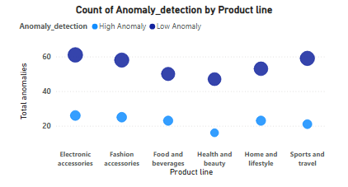
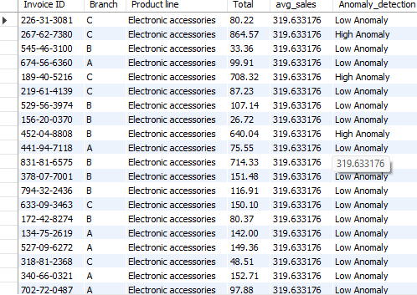
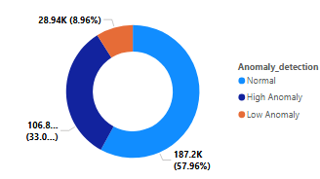
Task 4: Detecting Anomalies in Sales Transactions
Key Insights:
Totally 41.96% of sales are anomalies compared to average
High anomalies are 33.0% and Low anomalies are 8.96%.
Anomalies appear across all product lines.
Recommendations:
Investigate high-invoice anomalies for bulk purchases, special deals, or possible errors.
Verify invoice calculations and discount applications.
Implement automated invoice anomaly alerts.

Slide 7
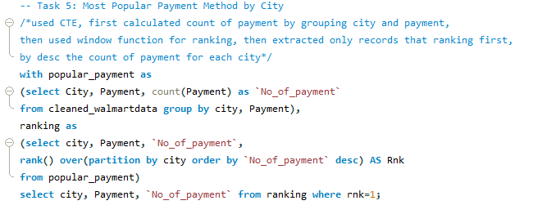
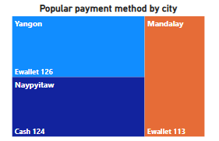

Task 5: Most Popular Payment Method by City
Key Insights:
Dataset contains three cities transaction data Mandalay, Naypyitaw, and Yangon.
Results shows more customers from Yangon and Mandalay prefers Ewallet payment method.
Customers from Naypyitaw mainly prefers Cash payment.
Recommendations:
Promote e-wallet offers in Yangon and Mandalay to strengthen preference.
Introduce e-wallet incentives in Naypyitaw to shift cash users to digital.
Maintain cash payment facilities in Naypyitaw to cater to current demand.

Slide 8
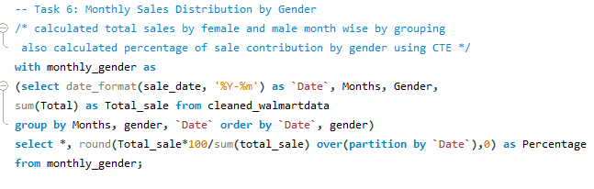
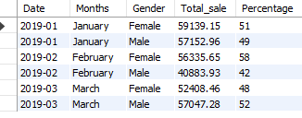
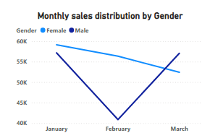
Task 6: Monthly Sales Distribution by Gender
Key Insights:
Data covers first three months: January, February, and March.
Female customers are contributed more in January(51%) and February(58%) month sales.
Male customers are most contributed in March month sales (52%).
Recommendations:
Plan gender-focused promotions to leverage higher engagement.
Explore product preferences by gender to tailor monthly marketing strategies.

Slide 9
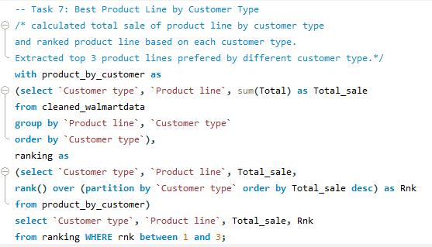
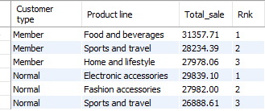
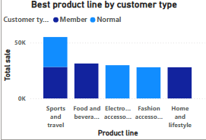
Task 7: Best Product Line by Customer Type
Key Insights:
Data contains two customer types: Membered and Normal.
Membered customers most preferred product line is ‘Food and beverages’ followed by ‘Sports and travels’.
Normal customers preferred ‘Electronics accessories’ product line the most and followed by ‘Fashion accessories’.
Recommendations:
Offer exclusive food and travel deals to retain and reward members.
Target normal customers with electronics and fashion promotions to increase conversions.
Create cross-sell bundles (e.g., electronics + food vouchers) to encourage broader purchases.

Slide 10
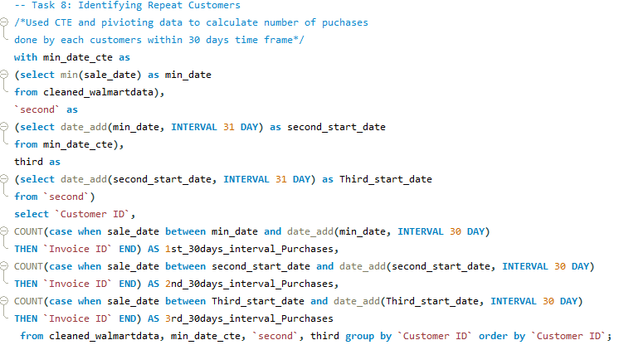
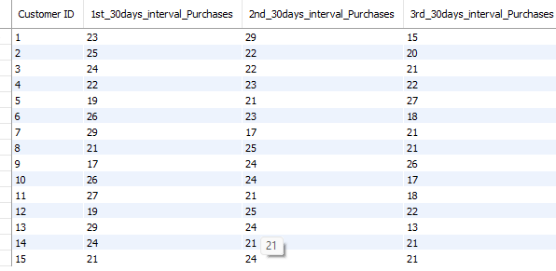
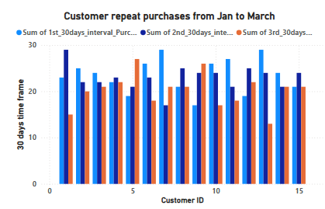
Task 8: Identifying Repeat Customers
Key Insights:
Dataset contains 15 customers invoice data over three months.
Each customer made 60+ purchases in overall three months.
Every customers made 10+ purchases for every 30 days of interval.
All the 15 are Repeat customers.
Recommendations:
Launch loyalty rewards to retain these high-frequency buyers.
Offer exclusive previews or discounts to encourage continued engagement.

Slide 11
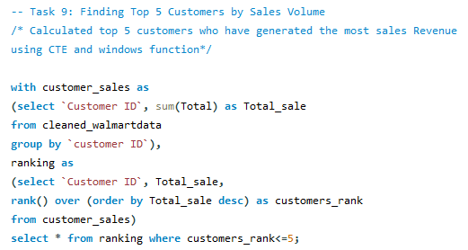
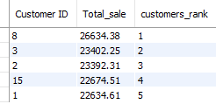
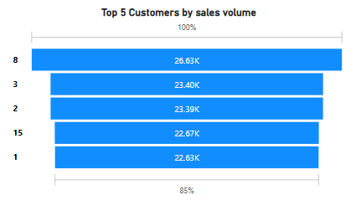
Task 9: Finding Top 5 Customers by Sales Volume
Key Insights:
Customer ID 8 is the highest contributor with sales of 26634.38.
Customers 3 and 2 ranked as top 2 and 3 with slight difference in total sales.
Followed customers 15 and 1 are in 4th and 5th position.
Recommendations:
Provide personalized offers or premium perks to top 5 to encourage continued high-value purchases.
Monitor for churn risk among these top contributors as losing them would significantly impact revenue.

Slide 12
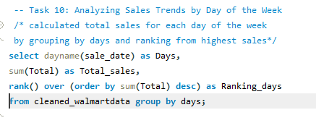
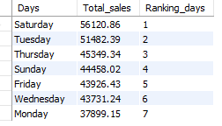
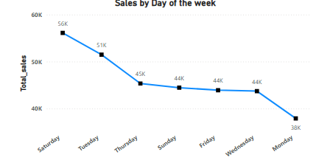
Task 10: Analyzing Sales Trends by Day of the Week
Key insights:
Saturday has highest sales, showing strong weekend shopping behavior.
Followed by Tuesday with 51482.39.
Midweek (Wed–Thu) sales are moderate but show potential for growth.
Monday has lowest sales, indicating a slow start to the week.
Recommendations:
On Saturdays and Tuesdays maintain strong promotions, use premium/high-margin products.
Try targeted campaigns to boost Sunday sales.
Boost Monday Sales by giving Monday-only discounts, combo offers to attract early-week customers.

Slide 13
Below is the link to the video presentation
https://drive.google.com/file/d/17KVQpZi5M3ZdKFUnowXg6HE7x2L-2jv_/view?usp=sharing

Slide 14
Thank You

